Slide 1


Thymeleaf with Spring Boot
© LLC

Slide 2




What is Thymeleaf?
Thymeleaf is a Java templating engine
.thymeleaf.org
Separate project Unrelated to spring.io
•
Commonly used to generate the HTML views for web apps
•
However, it is a general purpose templating engine
•
Can use Thymeleaf outside of web apps (more on this later)

Slide 3

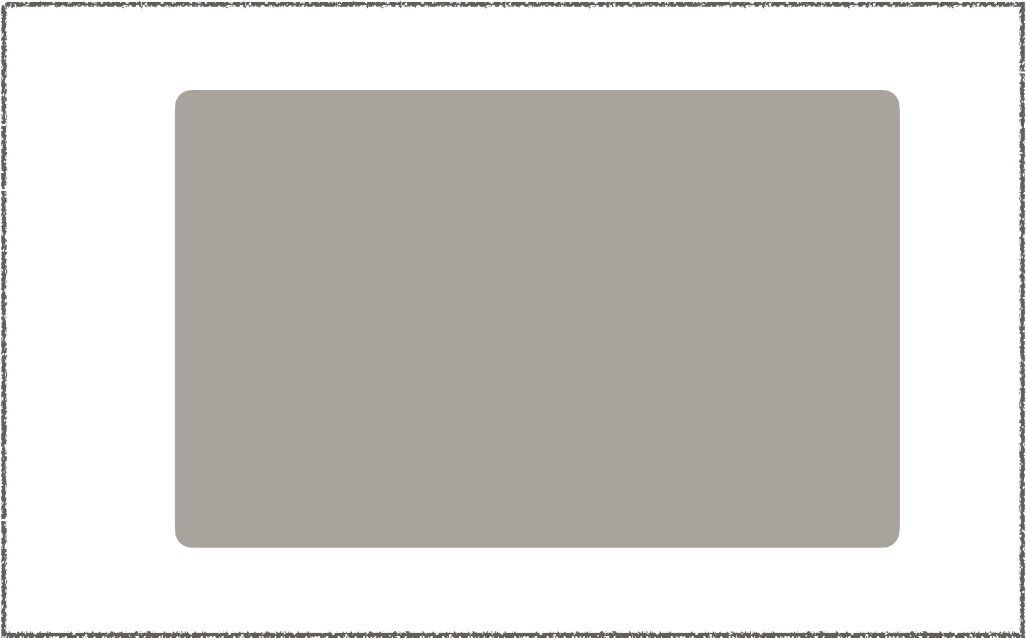

What is a Thymeleaf template?
Can be an HTML page with some Thymeleaf expressions
Include dynamic content from Thymeleaf expressions
HTML code
Can access Java code, objects
Spring beans
Thymeleaf expressions
.

Slide 4

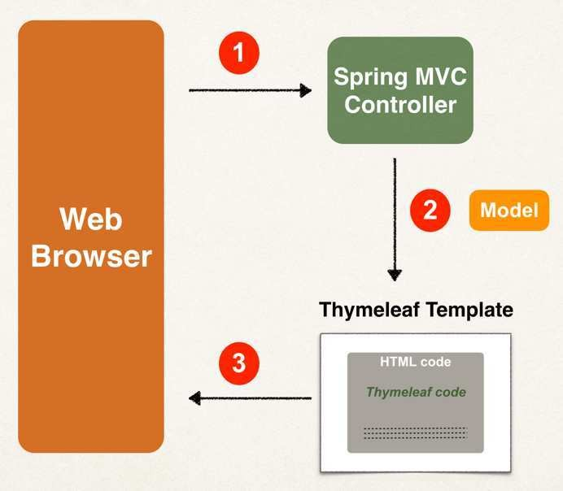
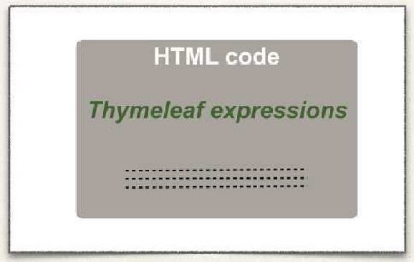
Where is the Thymeleaf template processed?
In a web app, Thymeleaf is processed on the server
Results included in HTML returned to browser
.

Slide 5


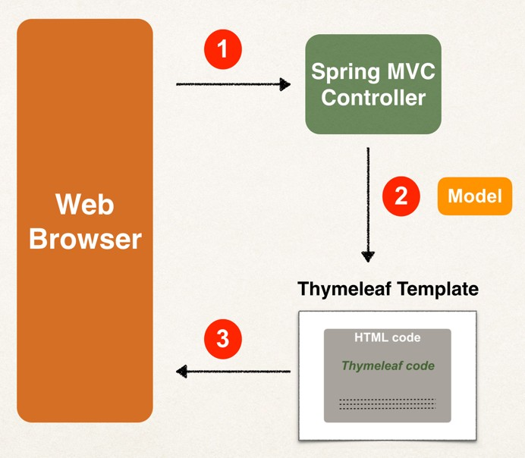

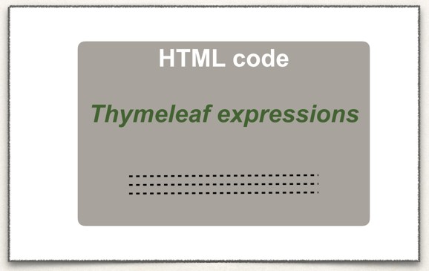



Thymeleaf Demo
Output
Time on the server is 20xx-03-30T11:27:52.297247
.

Slide 6
Development Process
Step-By-Step
Add Thymeleaf to Maven POM file
Develop Spring MVC Controller
Create Thymeleaf template
.

Slide 7



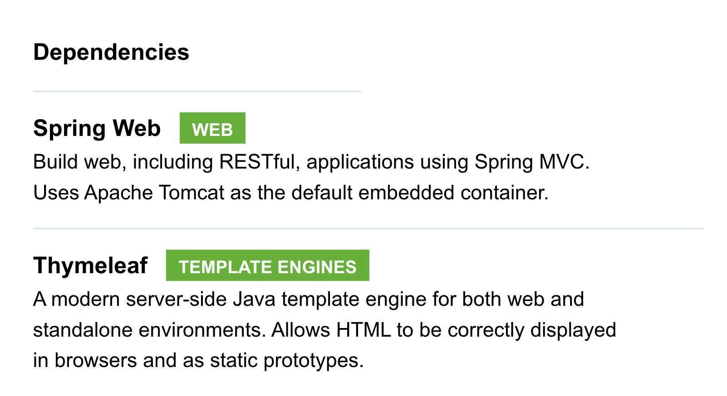


Step 1: Add Thymeleaf to Maven pom file
<dependency>
<groupId>org.springframework.boot</groupId>
<artifactId>spring-boot-starter-thymeleaf</artifactId>
</dependency>
Based on this,
Spring Boot will auto configure to use Thymeleaf templates
.

Slide 8



Step 2: Develop Spring MVC Controller
File: DemoController.java
@Controller
public class DemoController {
@GetMapping("/")
public String sayHello(Model theModel) {
theModel.addAttribute("theDate", java.time.LocalDateTime.now()); return "helloworld";
}
}
src/main/resources/templates/helloworld.html
.

Slide 9
Where to place Thymeleaf template?
In Spring Boot, your Thymeleaf template files go in
src/main/resources/templates
•
For web apps, Thymeleaf templates have a .html extension
.

Slide 10










Step 3: Create Thymeleaf template
File: DemoController.java
Thymeleaf accesses "theDate"
from the Spring MVC Model
@Controller
public class DemoController {
@GetMapping("/")
public String sayHello(Model theModel) {
File: src/main/resources/templates/helloworld.html
_{To use T}t_{h}he_{y}M_{m}od_{e}el_{le}.a_{a}d_{f}dAttribute("theDate",java.time.LocalDateTime.now());
<!DOCTYPE HTML>
<html xmlns:th="http:// .thymeleaf.org">
<head> … </head>
exprersetsuironn"shelloworld";
}
1
}
<body>
<p th:text="'Time on the server is ' + ${theDate}" />
</body>
</html>
2
Thymeleaf expression
Time on the server is 20xx-03-30T11:27:52.297247
.

Slide 11


Step 3: Create Thymeleaf template
File: DemoController.java
Thymeleaf accesses "theDate"
from the Spring MVC Model
@Controller
public class DemoController {
@GetMapping("/")
public String sayHello(Model theModel) {
File: src/main/resources/templates/helloworld.html
theModel.addAttribute("theDate",java.time.LocalDateTime.now());
<!DOCTYPE HTML>
<html xmlns:th="http:// .thymeleaf.org">
<head> … </head>
return "helloworld";
1
}
}
<body>
<p th:text="'Time on the server is ' + ${theDate}" />
</body>
</html>
2
Thymeleaf expression
Time on the server is 20xx-03-30T11:27:52.297247
.

Slide 12

Additional Features
Looping and conditionals
CSS and JavaScript integration
Template layouts and fragments
.thymeleaf.org
.

Slide 13
CSS and Thymeleaf
© LLC

Slide 14
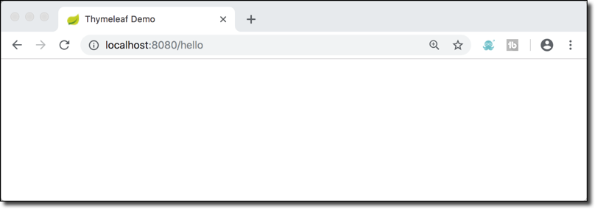


Let's Apply CSS Styles to our Page
Before
After
Time on the server is 20xx-03-30T14:07:50.339905
Time on the server is 20xx-03-30T14:07:50.339905
Time on the server is Sat Jan 05 11:42:13 EST 2019
Time on the server is Sat Jan 05 11:42:13 EST 2019
font-style: italic; color: green;
.

Slide 15
Using CSS with Thymleaf Templates
You have the option of using
Local CSS files as part of your project
Referencing remote CSS files
•
We'll cover both options in this video
.

Slide 16
Development Process
Step-By-Step
Create CSS file
Reference CSS in Thymeleaf template
Apply CSS style
.

Slide 17




Step 1: Create CSS file
Spring Boot will look for static resources in the directory
src/main/resources/static
You can create your own custom sub-directories static/css
static/images static/js
etc …
src/main/resources static
css
File: demo.css
.funny {
font-style: italic; color: green;
}
demo.css
Can be any sub-directory name
.

Slide 18



Step 2: Reference CSS in Thymeleaf template
File: helloworld.html
@ symbol
<head>
<title>Thymeleaf Demo</title>
Reference context path of your application
(app root)
<!-- reference CSS file -->
<link rel="stylesheet" th:href="@{/css/demo.css}" />
</head>
src/main/resources static
css
demo.css
.

Slide 19




Step 3: Apply CSS
File: demo.css
File: helloworld.html
.funny {
<head>
<title>Thymeleaf Demo</title>
font-style: italic;
color: green;
}
<!-- reference CSS file -->
<link rel="stylesheet" th:href="@{/css/demo.css}" />
</head>
<body>
<p th:text="'Time on the server is ' + ${theDate}" class="funny" />
</body>
Time on the server is 20xx-03-30T14:07:50.339905
Time on the server is Sat Jan 05 11:42:13 EST
.

Slide 20


Other search directories
Spring Boot will search following directories for static resources:
/src/main/resources
1. /META-INF/resources
/resources
/static
/public
Search order: top-down
.

Slide 21
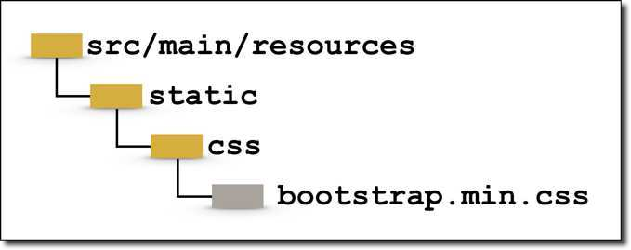

3rd Party CSS Libraries - Bootstrap
Local Installation
Download Bootstrap file(s) and add to /static/css directory
<head>
… …
<!-- reference CSS file -->
<link rel="stylesheet" th:href="@{/css/bootstrap.min.css}" />
</head>
.

Slide 22
3rd Party CSS Libraries - Bootstrap
Remote Files
<head>
… …
<!-- reference CSS file -->
<link rel="stylesheet" href="https://cdn.jsdelivr.net/npm/bootstrap@5.2.3/dist/css/bootstrap.min.css" />
… …
</head>
.

Slide 23


Spring MVC Behind the Scenes
Date
© LLC

Slide 24


Components of a Spring MVC Application
Web Pages
•
A set of web pages to layout UI components
•
A collection of Spring beans (controllers, services, etc…)
Beans
•
Spring configuration (XML, Annotations or Java)
Spring Configuration
.

Slide 25

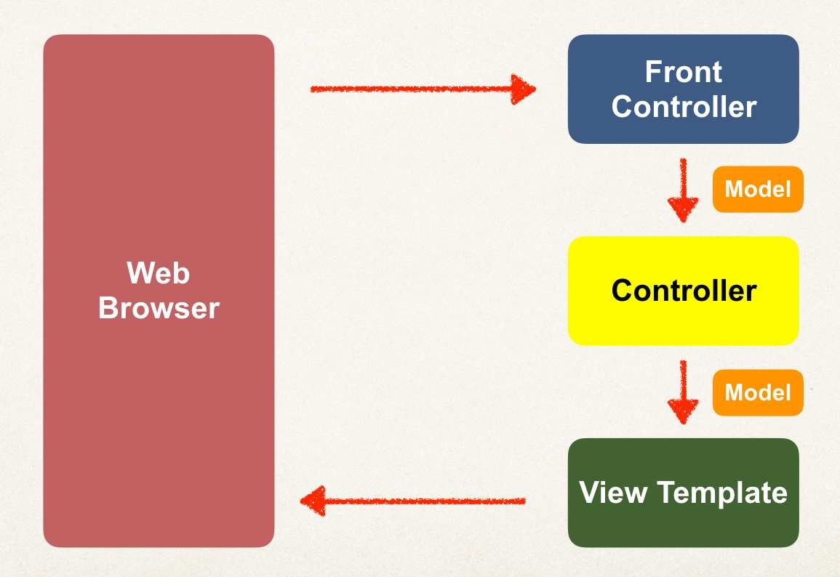
How Spring MVC Works Behind the Scenes
.

Slide 26

Spring MVC Front Controller
Front controller known as DispatcherServlet
Part of the Spring Framework
Already developed by Spring Dev Team
•
You will create
•
Model objects (orange)
•
View templates (dark green)
•
Controller classes (yellow)
.

Slide 27

Controller
Code created by developer
•
Contains your business logic
Handle the request
Store/retrieve data (db, web service…)
Place data in model
•
Send to appropriate view template
.

Slide 28
Model
•
Model: contains your data
•
Store/retrieve data via backend systems
•
database, web service, etc…
•
Use a Spring bean if you like
•
Place your data in the model
•
Data can be any Java object/collection
.

Slide 29
View Template
Spring MVC is flexible
Supports many view templates
•
Recommended: Thymeleaf
•
Developer creates a page
•
Displays data
.

Slide 30

View Template (more)
Other view templates supported
Groovy, Velocity, Freemarker, etc…
•
For details, see:
. /spring-mvc-views
.

Slide 31
Reading Form Data with Spring MVC
Date
© LLC

Slide 32
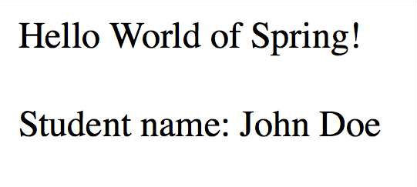
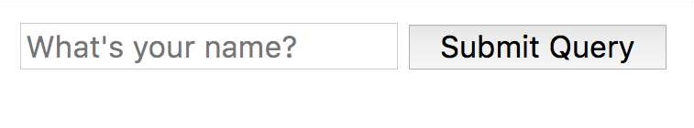

High Level View
helloworld.html
helloworld-form.html
.

Slide 33
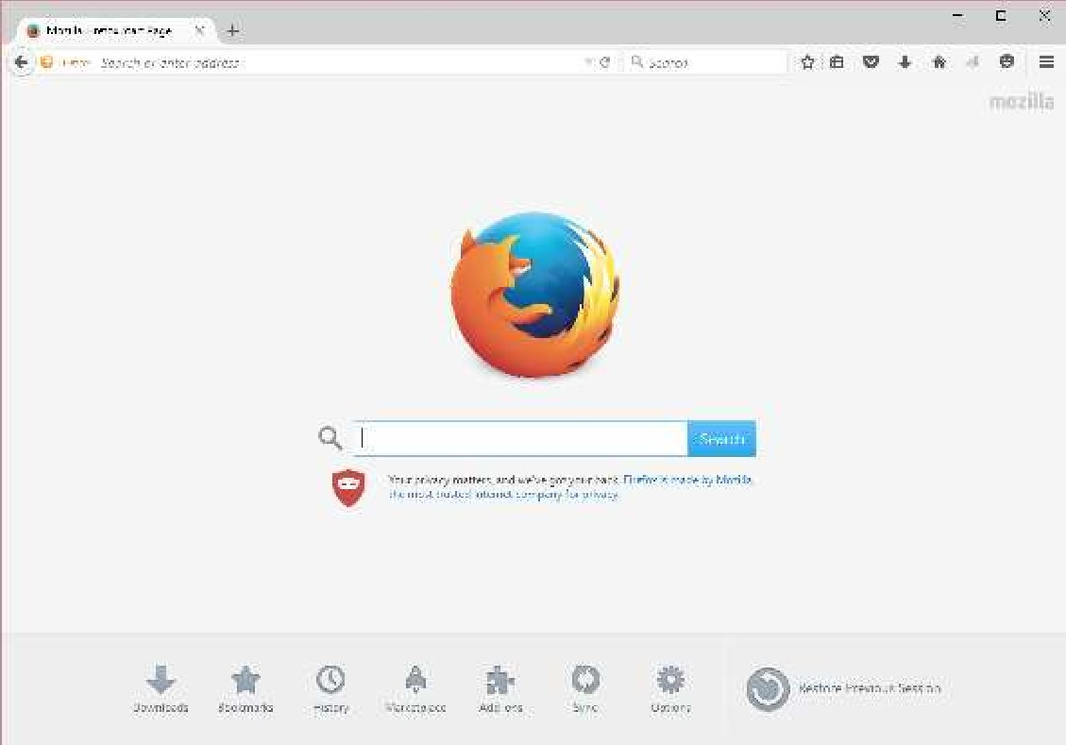



Application Flow
Request Mapping
helloworld-form.html
/showForm
HelloWorld Controller
.

Slide 34




Application Flow
Request Mapping
helloworld-form.html
/showForm
HelloWorld Controller
Request Mapping
helloworld-form.html
/processForm
helloworld.html
HelloWorld Controller
.

Slide 35
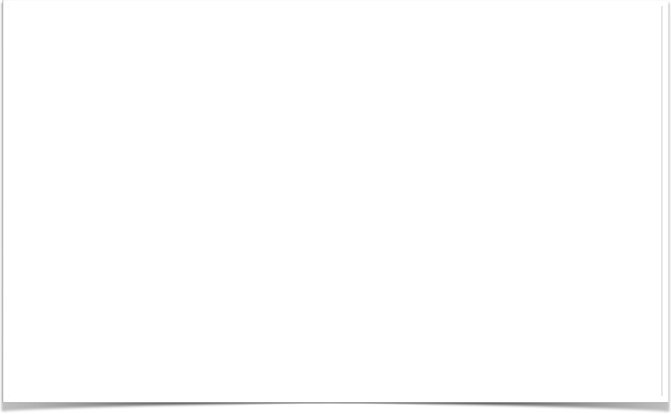
Controller Class
@Controller
public class HelloWorldController {
// need a controller method to show the initial HTML form @RequestMapping("/showForm")
public String showForm() { return "helloworld-form";
}
// need a controller method to process the HTML form @RequestMapping("/processForm")
public String processForm() { return "helloworld";
}
}
.

Slide 36
Development Process
Create Controller class
Show HTML form
Create controller method to show HTML Form
Create View Page for HTML form
Process HTML Form
Create controller method to process HTML Form
Develop View Page for Confirmation
Step-By-Step
.

Slide 37
Adding Data to Spring Model
Date
© LLC

Slide 38
Focus on the Model
.

Slide 39

Spring Model
The Model is a container for your application data
•
In your Controller
•
You can put anything in the model
•
strings, objects, info from database, etc…
•
Your View page can access data from the model
.

Slide 40
Code Example
We want to create a new method to process form data
•
Read the form data: student’s name
•
Convert the name to upper case
•
Add the uppercase version to the model
.

Slide 41
Passing Model to your Controller
@RequestMapping("/processFormVersionTwo")
public String letsShoutDude(HttpServletRequest request, Model model) {
// read the request parameter from the HTML form
String theName = request.getParameter("studentName");
// convert the data to all caps theName = theName.toUpperCase();
// create the message
String result = "Yo! " + theName;
// add message to the model model.addAttribute("message", result);
return "helloworld";
}
.

Slide 42

View Template - Thymeleaf
<html><body>
Hello World of Spring!
...
The message: <span th:text=“${message}” />
</body></html>
.

Slide 43
Adding more data to your Model
// get the data
//
String result = …
List<Student> theStudentList = … ShoppingCart theShoppingCart = …
// add data to the model
//
model.addAttribute("message", result);
model.addAttribute("students", theStudentList); model.addAttribute("shoppingCart", theShoppingCart);
.

Slide 44
Reading HTML Form Data with @RequestParam Annotation
Date
© LLC

Slide 45
Code Example
We want to create a new method to process form data
•
Read the form data: student’s name
•
Convert the name to upper case
•
Add the uppercase version to the model
.

Slide 46
Instead of using HttpServletRequest
@RequestMapping("/processFormVersionTwo")
public String letsShoutDude(HttpServletRequest request, Model model) {
// read the request parameter from the HTML form
String theName = request.getParameter("studentName");
…
}
.

Slide 47
Bind variable using @RequestParam Annotation
@RequestMapping("/processFormVersionTwo")
public String letsShoutDude( @RequestParam("studentName") String theName, Model model) {
// now we can use the variable: theName
}
Behind the scenes:
Spring will read param from request: studentName Bind it to the variable: theName
.

Slide 48
@GetMapping and @PostMapping
© LLC

Slide 49



HTTP Request / Response
request
Spring MVC Controller
HTML Form
response
.

Slide 50





Most Commonly Used HTTP Methods
Method Description
GET | Requests data from given resource
POST | Submits data to given resource
others | …
.

Slide 51

Sending Data with GET method
<form th:action=“@{/processForm}” method="GET" …>
…
</form>
•
Form data is added to end of URL as name/value pairs
•
theUrl?field1=value1&field2=value2…
.

Slide 52
Handling Form Submission
@RequestMapping("/processForm") public String processForm(...) {
...
}
•
This mapping handles ALL HTTP methods
•
GET, POST, etc …
.

Slide 53
Constrain the Request Mapping - GET
@RequestMapping(path="/processForm", method=RequestMethod.GET) public String processForm(...) {
...
}
•
This mapping ONLY handles GET method
•
Any other HTTP REQUEST method will get rejected
.

Slide 54

Annotation Short-Cut
@GetMapping("/processForm") public String processForm(...) {
...
}
•
@GetMapping: this mapping ONLY handles GET method
•
Any other HTTP REQUEST method will get rejected
.

Slide 55

Sending Data with POST method
<form th:action=“@{/processForm}” method="POST" …>
…
</form>
•
Form data is passed in the body of HTTP request message
.

Slide 56

Sending Data with POST method
headers request body
(form data)
Spring MVC Controller
HTML Form
.

Slide 57
Constrain the Request Mapping - POST
@RequestMapping(path="/processForm", method=RequestMethod.POST) public String processForm(...) {
...
}
•
This mapping ONLY handles POST method
•
Any other HTTP REQUEST method will get rejected
.

Slide 58

Annotation Short-Cut
@PostMapping("/processForm") public String processForm(...) {
...
}
•
@PostMapping: This mapping ONLY handles POST method
•
Any other HTTP REQUEST method will get rejected
.

Slide 59


Well …. which one???
GET
Good for debugging
Bookmark or email URL
Limitations on data length
POST
Can’t bookmark or email URL
No limitations on data length
Can also send binary data
.

Slide 60
Spring MVC Form Tag - Text Field
© LLC

Slide 61
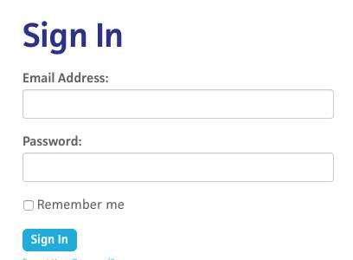
Review HTML Forms
HTML Forms are used to get input from the user
.

Slide 62
Data Binding
Spring MVC forms can make use of data binding
•
Automatically setting / retrieving data from a Java object / bean
.

Slide 63


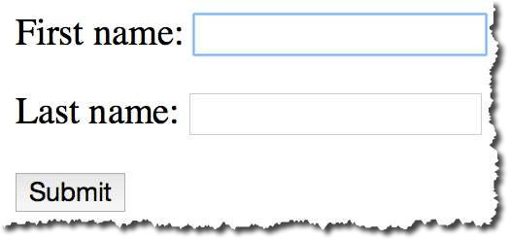


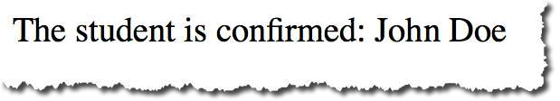
Big Picture
student-form.html
Student
Student Controller
Student
student-confirmation.html
.

Slide 64
Showing Form
In your Spring Controller
•
Before you show the form, you must add a model attribute
•
This is a bean that will hold form data for the data binding
.

Slide 65
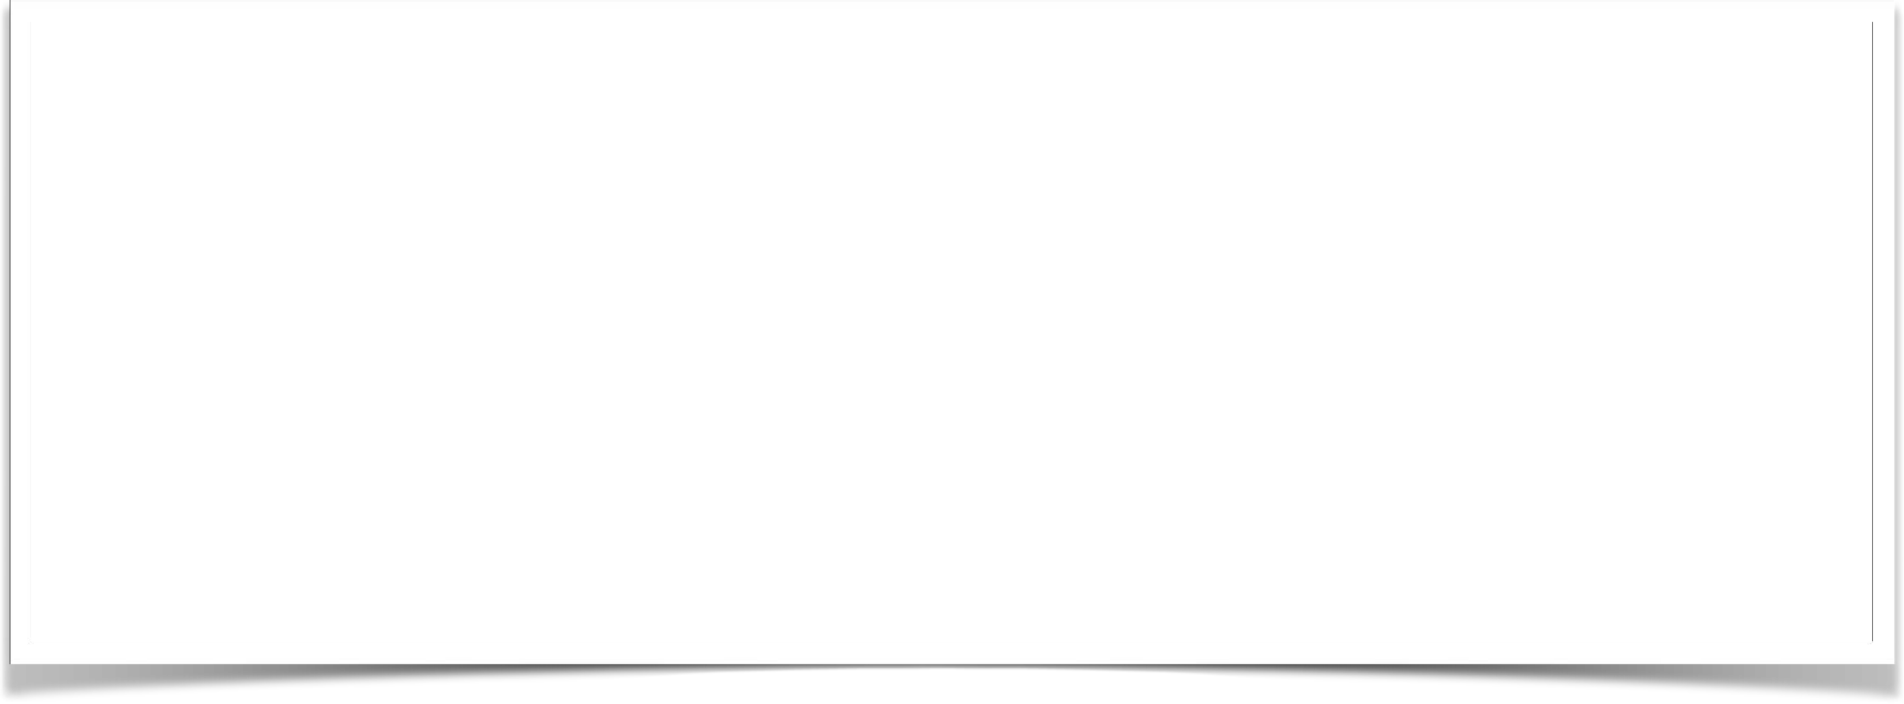
Show Form - Add Model Attribute
Code snippet from Controller
@GetMapping("/showStudentForm") public String showForm(Model theModel) {
theModel.addAttribute("student", new Student()); return "student-form";
}
.

Slide 66
Setting up HTML Form - Data Binding
<form th:action="@{/processStudentForm}" th:object="${student}" method="POST">
First name: <input type="text" th:field="*{firstName}" />
<br><br>
Last name: <input type="text" th:field="*{lastName}" />
<br><br>
<input type="submit" value="Submit" />
</form>
.

Slide 67



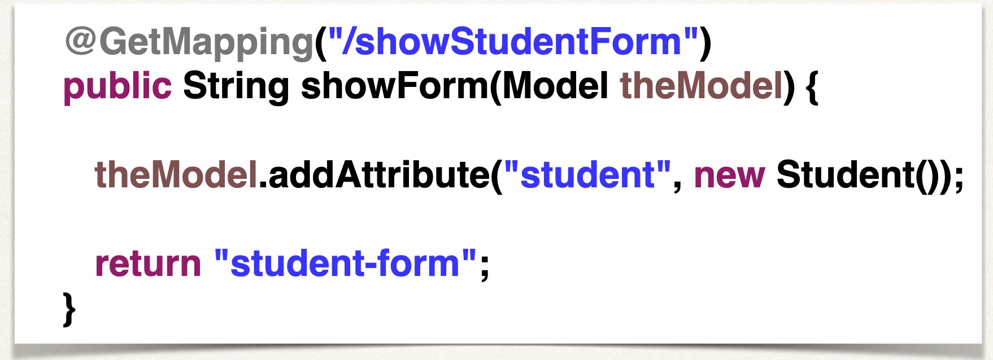

Setting up HTML Form - Data Binding
Name of model attribute
<form th:action="@{/processStudentForm}" th:object="${student}" method="POST">
First name: <input type="text" th:field="*{firstName}" />
<br><br>
Last name: <input type="text" th:field="*{lastName}" />
<br><br>
<input type="submit" value="Submit" />
</form>
.

Slide 68



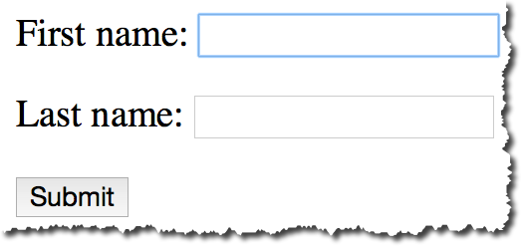


Setting up HTML Form - Data Binding
<form th:action="@{/processStudentForm}" th:object="${student}" method="POST">
First name: <input type="text" th:field="*{firstName}" />
<br><br>
*{ … } is shortcut syntax for: ${student.firstName}
Last name: <input type="text" th:field="*{lastName}" />
<br><br>
*{ … } is shortcut syntax for: ${student.lastName}
<input type="submit" value="Submit" />
</form>
.

Slide 69



When Form is Loaded … fields are populated
<form th:action="@{/processStudentForm}" th:object="${student}" method="POST">
First name: <input type="text" th:field="*{firstName}" />
When form is loaded,
<br><br>
Spring MVC will read student
from the model, then call:
Last name: <input type="text" th:field="*{lastName}" />
<br><br>
student.getFirstName()
… student.getLastName()
<input type="submit" value="Submit" />
</form>
.

Slide 70



When Form is submitted … calls setter methods
<form th:action="@{/processStudentForm}" th:object="${student}" method="POST">
First name: <input type="text" th:field="*{firstName}" />
When form is submitted, Spring MVC will
<br><br>
create a new Student instance
Last name: <input type="text" th:field="*{lastName}" />
and add to the model, then call:
<br><br>
<input type="submit" value="Submit" />
student.setFirstName(…)
… student.setLastName(…)
</form>
.

Slide 71
Handling Form Submission in the Controller
Code snippet from Controller
@PostMapping("/processStudentForm")
public String processForm(@ModelAttribute("student") Student theStudent) {
// log the input data
System.out.println("theStudent: " + theStudent.getFirstName()
+ " " + theStudent.getLastName());
return "student-confirmation";
}
.

Slide 72





Confirmation page
<html>
Calls student.getFirstName()
Calls student.getLastName()
<body>
The student is confirmed: <span th:text="${student.firstName} + ' ' + ${student.lastName}" />
</body>
</html>
.

Slide 73
Pulling It All Together
student-form.html
Student
Student Controller
Student
student-confirmation.html
.

Slide 74
Development Process
Step-By-Step
Create Student class
Create Student controller class
Create HTML form
Create form processing code
Create confirmation page
.

Slide 75
Spring MVC Form - Drop Down List
© LLC

Slide 76



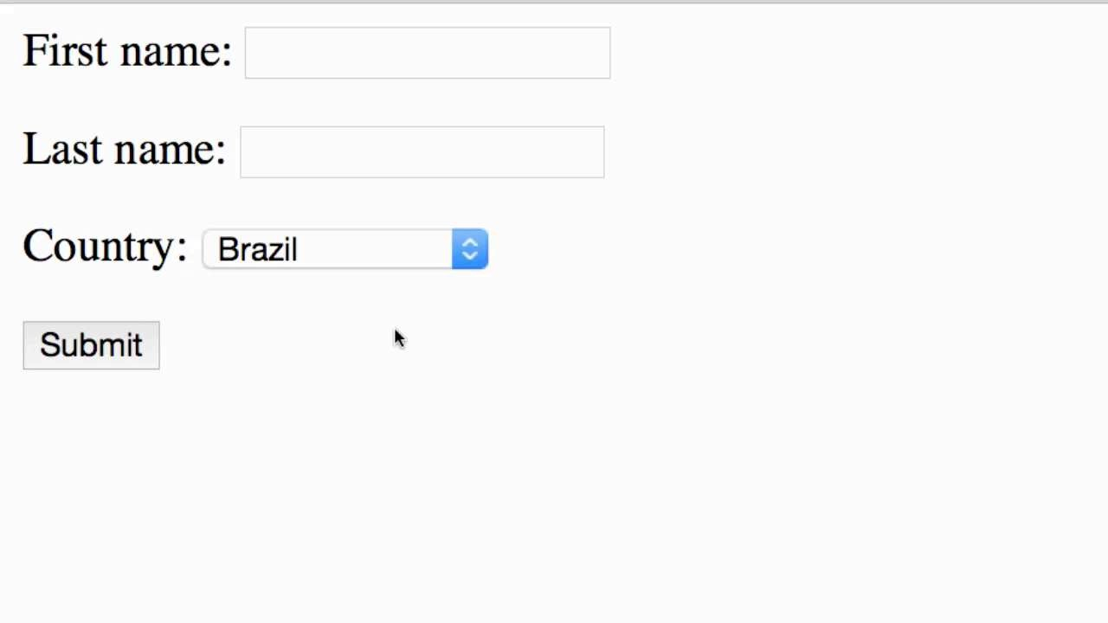




Review of HTML <select> Tag
BR FR DE IN
<select name="country">
<option
<option
<option
<option
...
</select>
value="Brazil">Brazil</option> value="France">France</option> value="Germany">Germany</option> value="India">India</option>
Displayed to user
Value sent during form submission
.

Slide 77



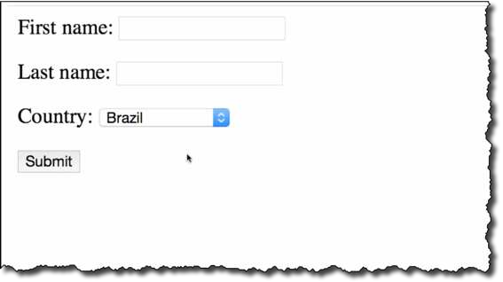
Thymeleaf and <select> tag
<select th:field="*{country}">
<option
<option
<option
<option
th:value="Brazil">Brazil</option> th:value="France">France</option> th:value="Germany">Germany</option> th:value="India">India</option>
</select>
Displayed to user
Value sent during form submission
.

Slide 78




Pulling It All Together
student-form.html
Student
student form
Student Controller
Student
student-confirmation.html
confirmation page
.

Slide 79
Development Process
Step-By-Step
Update HTML form
Update Student class - add getter/setter for new property
Update confirmation page
.

Slide 80
Spring MVC Form - Radio Buttons
© LLC

Slide 81

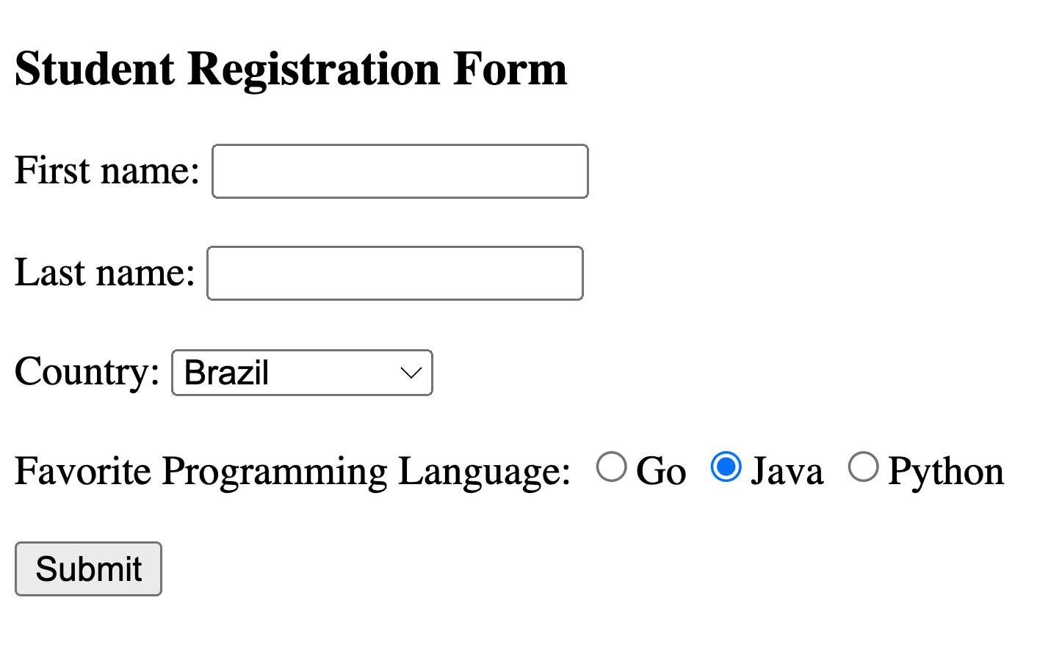

Radio Buttons
.

Slide 82






Code Example
Favorite
Programming
Language:
<input | type="radio" | th:field="*{favoriteLanguage}" | th:value="Go">Go</input>
<input | type="radio" | th:field="*{favoriteLanguage}" | th:value="Java">Java</input>
<input | type="radio" | th:field="*{favoriteLanguage}" | th:value="Python">Python</input>
Binding to property on Student object
Value sent during form submission
Displayed to user
.

Slide 83
Pulling It All Together
student-form.html
Student
student form
Student Controller
Student
student-confirmation.html
confirmation page
.

Slide 84
Development Process
Step-By-Step
Update HTML form
Update Student class - add getter/setter for new property
Update confirmation page
.

Slide 85
Spring MVC Forms - Check Box
© LLC

Slide 86
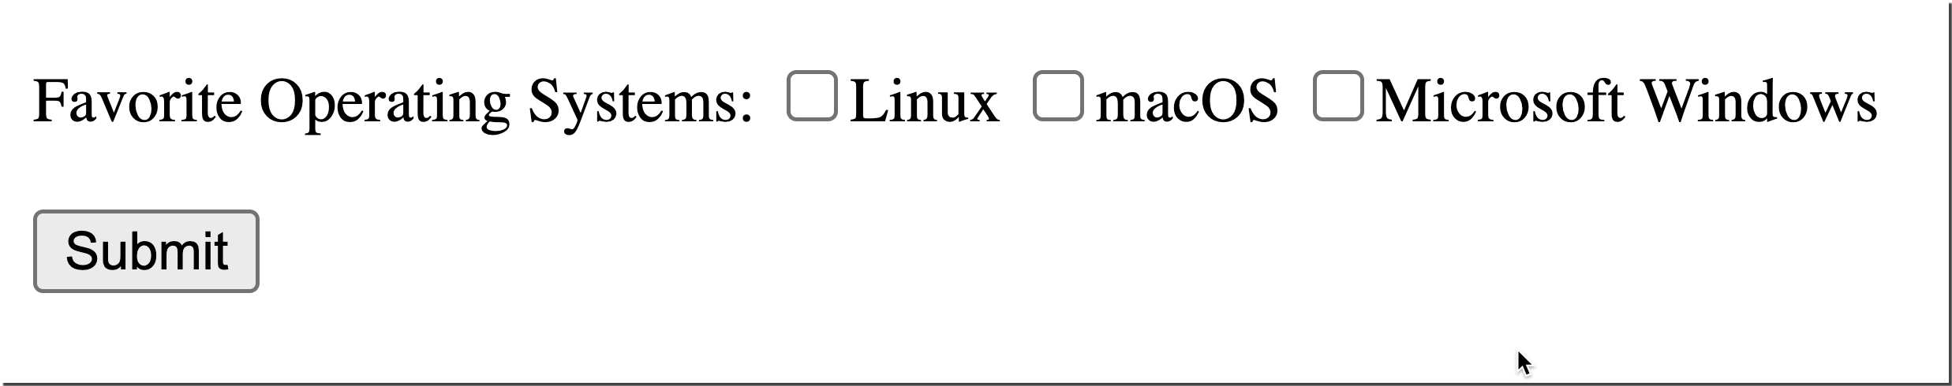
Check Box - Pick Your Favorite Operating Systems
.

Slide 87
Code Example
<input | type="checkbox" | th:field="*{favoriteSystems}" th:value="Linux">Linux</input>
<input | type="checkbox" | th:field="*{favoriteSystems}" th:value="macOS">macOS</input>
<input | type="checkbox" | th:field="*{favoriteSystems}"
 |  | th:value="'Microsoft Windows'">Microsoft Windows</input>
.

Slide 88






Pulling It All Together
student-form.html
Student
student form
Student Controller
Student
student-confirmation.html
confirmation page
.

Slide 89
Development Process
Step-By-Step
Update HTML form
Update Student class - add getter/setter for new property
Update confirmation page
.

Slide 90
Spring MVC Form Validation
© LLC

Slide 91
The Need for Validation
Check the user input form for
required fields valid numbers in a range valid format (postal code)
custom business rule
.

Slide 92
Java’s Standard Bean Validation API
Java has a standard Bean Validation API
Defines a metadata model and API for entity validation
Spring Boot and Thymeleaf also support the Bean Validation API
http:// .beanvalidation.org
.

Slide 93





Bean Validation Features
Validation Feature
required
validate length
validate numbers
validate with regular expressions
custom validation
.

Slide 94
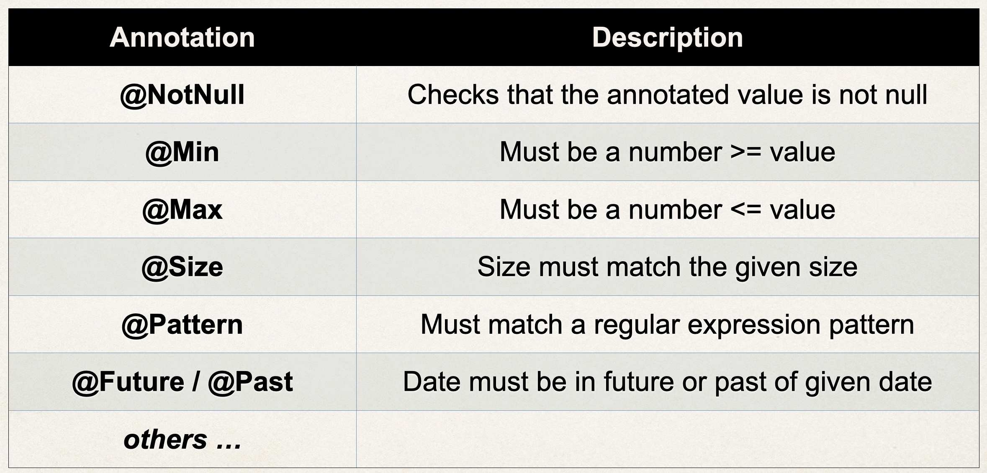
Validation Annotations
.

Slide 95
Our Road Map
set up our development environment
required field
validate number range: min, max
validate using regular expression (regexp)
custom validation
.

Slide 96
Spring MVC Form Validation Required Fields
© LLC

Slide 97
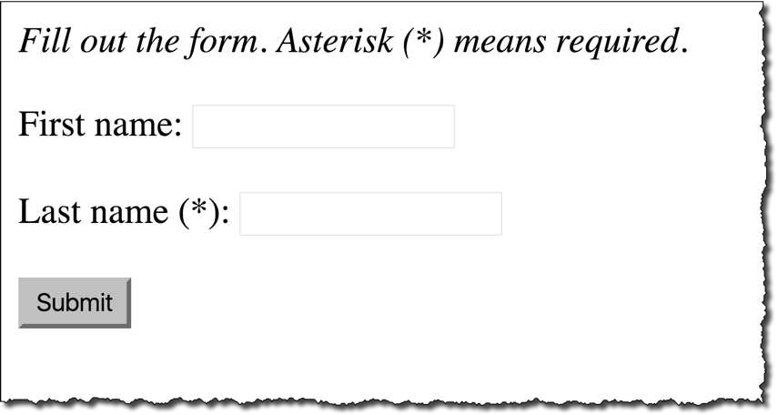
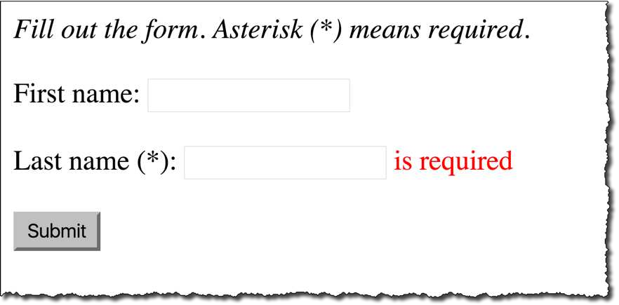

Required Fields
.

Slide 98

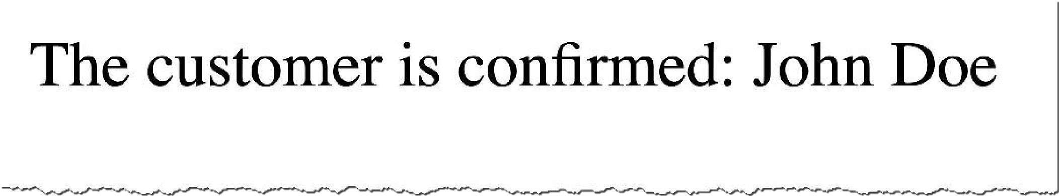
Pulling It All Together
customer-form.html
Customer
Customer Controller
Customer
customer-confirmation.html
.

Slide 99
Development Process
Step-By-Step
Create Customer class and add validation rules
Add Controller code to show HTML form
Develop HTML form and add validation support
Perform validation in the Controller class
Create confirmation page
.

Slide 100


Step 1: Create Customer class and add validation rules
File: Customer.java
import import
jakarta.validation.constraints.NotNull; jakarta.validation.constraints.Size;
public class Customer {
private String firstName;
@NotNull(message = "is required") @Size(min=1, message = "is required") private String lastName = “”;
// getter/setter methods …
Validation rules
}
.

Slide 101



Step 2: Add Controller code to show HTML form
File: CustomerController.java
import import import
org.springframework.stereotype.Controller; org.springframework.web.bind.annotation.GetMapping; org.springframework.ui.Model;
Model allows us to share
@Controller
public class CustomerController {
@GetMapping("/")
public String showForm(Model
information between Controllers and view pages (Thymeleaf)
theModel) {
theModel.addAttribute("customer", new Customer());
return "customer-form";
}
name
value
…
}
.

Slide 102


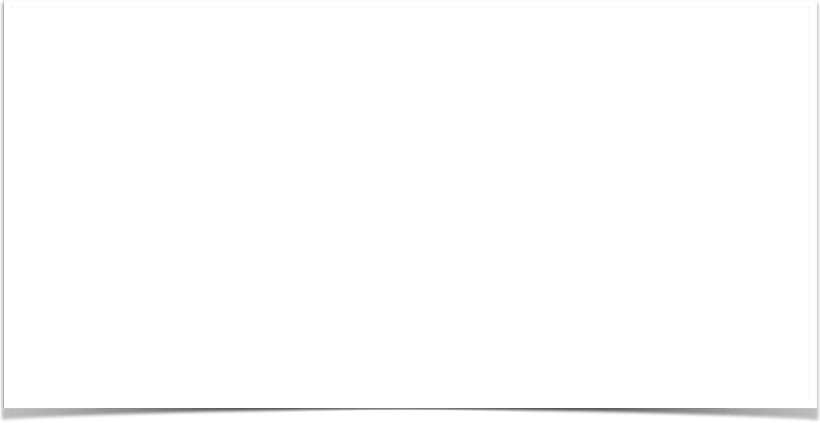


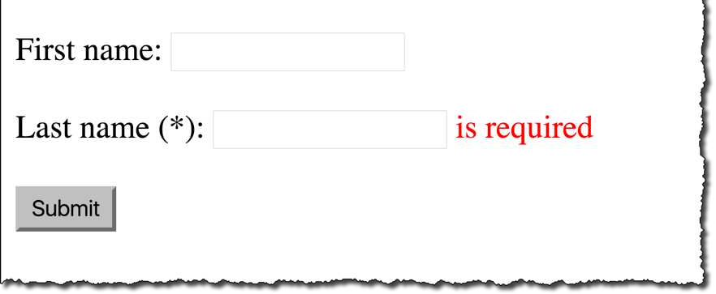
Step 3: Develop HTML form and add validation support
Where to submit form data
Model attribute name
File: customer-form.html
<form th:action="@{/processForm}" th:object="${customer}" method="POST">
First name: <input type="text" th:field="*{firstName}" />
<br><br>
Property name from Customer class
Last name (*): <input type="text" th:field="*{lastName}" />
Property name from Customer class
<!-- Show error message (if present) -->
<span th:if="${#fields.hasErrors('lastName')}"
th:errors="*{lastName}"
class="error"></span>
<br><br>
<input type="submit" value="Submit" />
</form>
.

Slide 103




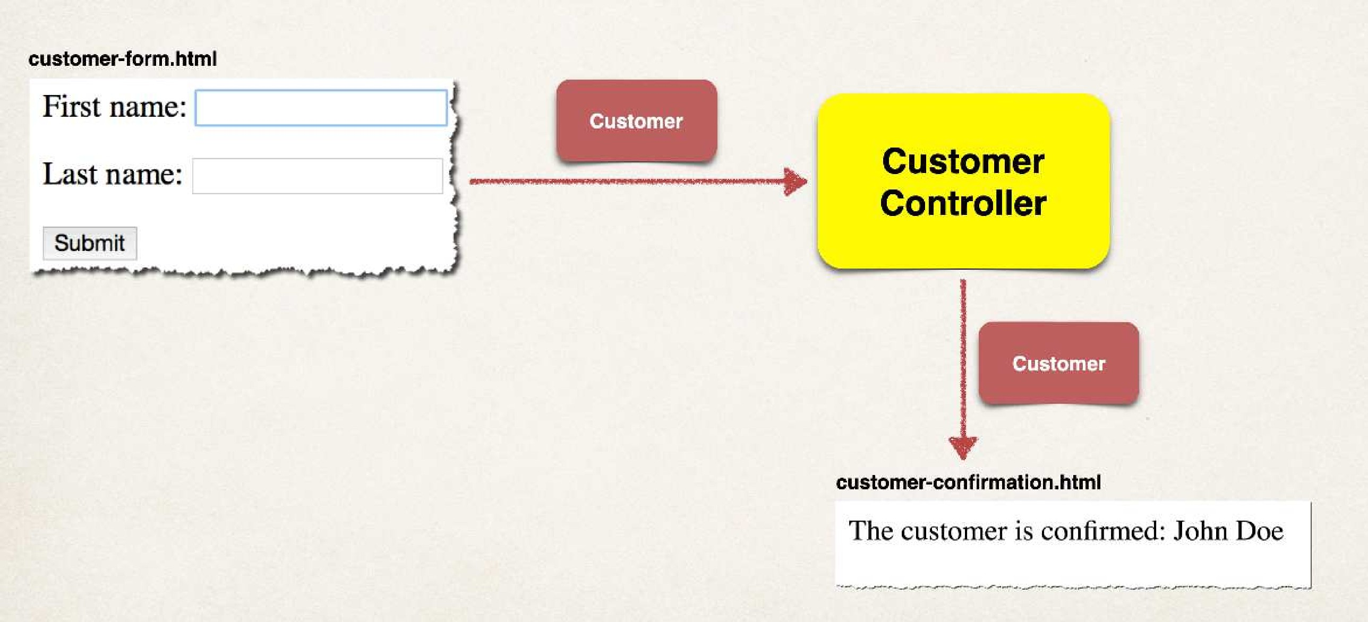
Step 4: Perform validation in Controller class
File: CustomerController.java
…
Model attribute name
@PostMapping("/processForm")
public String processForm(
@Valid @ModelAttribute("customer")
Tell Spring MVC to perform validation
Customer
theCustomer,
BindingResult theBindingResult) {
if (theBindingResult.hasErrors()) {
return "customer-form";
The results of validation
}
else {
return
"customer-confirmation";
}
}
.

Slide 104
Step 5: Create confirmation page
File: customer-confirmation.html
<!DOCTYPE
html>
<html xmlns:th="http:// .thymeleaf.org">
<body>
The customer
</body>
is confirmed: <span th:text="${customer.firstName + ' ' + customer.lastName}" />
</html>
.

Slide 105
Spring MVC Validation @InitBinder
© LLC

Slide 106
White Space
Our previous example had a problem with white space
Last name field with all whitespace passed … YIKES!
Should have failed!
•
We need to trim whitespace from input fields
.

Slide 107
@InitBinder
Advanced
@InitBinder annotation works as a pre-processor
•
It will pre-process each web request to our controller
•
Method annotated with @InitBinder is executed
.

Slide 108
@InitBinder
We will use this to trim Strings
Remove leading and trailing white space
•
If String only has white spaces … trim it to null
•
Will resolve our validation problem … whew :-)
.

Slide 109
Register Custom Editor in Controller
CustomerController.java
…
@InitBinder
public void initBinder(WebDataBinder dataBinder) {
StringTrimmerEditor stringTrimmerEditor = new StringTrimmerEditor(true); dataBinder.registerCustomEditor(String.class, stringTrimmerEditor);
}
…
.

Slide 110
Spring MVC Validation Number Range: @Min and @Max
© LLC

Slide 111
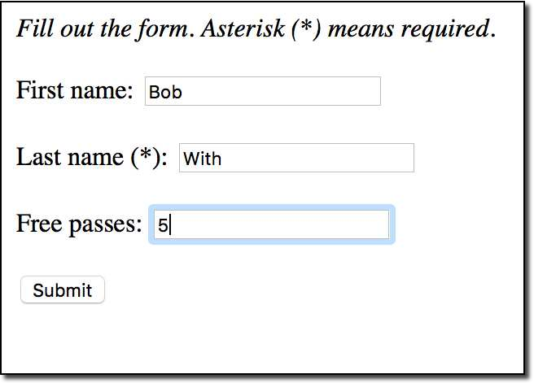
Validate a Number Range
•
Add a new input field on our form for: Free Passes
•
User can only enter a range: 0 to 10
.

Slide 112
Development Process
Step-By-Step
Add validation rule to Customer class
Display error messages on HTML form
Perform validation in the Controller class
Update confirmation page
.

Slide 113
Step 1: Add validation rule to Customer class
import jakarta.validation.constraints.Min; import jakarta.validation.constraints.Max;
public class Customer {
@Min(value=0, message="must be greater than or equal to zero") @Max(value=10, message="must be less than or equal to 10") private int freePasses;
// getter/setter methods
}
.

Slide 114
Development Process
Step-By-Step
Add validation rule to Customer class
Display error messages on HTML form
Perform validation in the Controller class
Update confirmation page
.

Slide 115
Spring MVC Validation Regular Expressions
© LLC

Slide 116
Regular Expressions
Advanced
A sequence of characters that define a search pattern
This pattern is used to find or match strings
Regular Expressions is like its own language (advanced topic)
I will assume you already know about regular expressions
If not, then plenty of free tutorials available
https://docs.oracle/javase/tutorial/essential/regex/
.

Slide 117
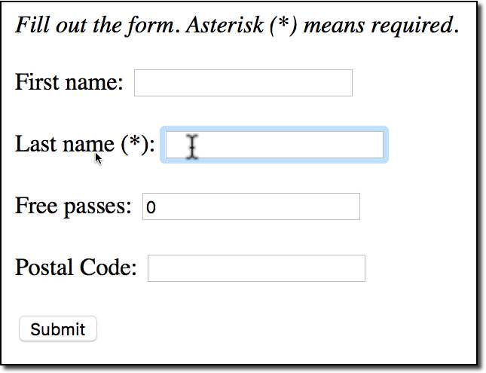
Validate a Postal Code
•
Add a new input field on our form for: Postal Code
•
User can only enter 5 chars / digits
•
Apply Regular Expression
.

Slide 118
Development Process
Step-By-Step
Add validation rule to Customer class
Display error messages on HTML form
Update confirmation page
.

Slide 119
Step 1: Add validation rule to Customer class
Advanced
import jakarta.validation.constraints.Pattern; public class Customer {
@Pattern(regexp="^[a-zA-Z0-9]{5}", message="only 5 chars/digits") private String postalCode;
// getter/setter methods
}
.

Slide 120

Spring MVC Validation Make an Integer Field Required
© LLC

Slide 121
Spring MVC Validation Handle String Input for Integer Fields
© LLC

Slide 122

Development Process
Step-By-Step
1. Create custom error message
src/resources/messages.properties
.
© LLC

Slide 123
Spring MVC Validation Custom Validation
© LLC

Slide 124
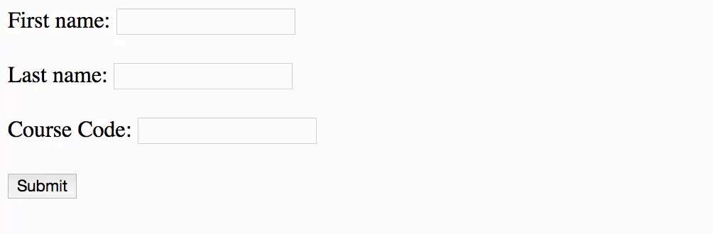
Custom Validation Demo
.

Slide 125
Custom Validation
✤ Perform custom validation based on your business rules
✤ Our example: Course Code must start with “LUV”
✤ Spring MVC calls our custom validation
✤ Custom validation returns boolean value for pass/fail (true/false)
.

Slide 126
Create a custom Java Annotation … from scratch
Advanced
✤ So far, we’ve used predefined validation rules: @Min, @Max, …
✤ For custom validation … we will create a Custom Java Annotation
✤ @CourseCode
@CourseCode(value="LUV", message="must start with LUV") private String courseCode;
.

Slide 127
Development Process
Step-By-Step
Create custom validation rule
Add validation rule to Customer class
Display error messages on HTML form
Update confirmation page
.

Slide 128
Development Process - Drill Down
Create custom validation rule
Create @CourseCode annotation
Create CourseCodeConstraintValidator
Step-By-Step
.

Slide 129

Step 1a: Create @CourseCode annotation
Advanced
Usage Example
@CourseCode(value="LUV", message="must start with LUV") private String courseCode;
.

Slide 130
Step 1a: Create @CourseCode annotation
Advanced
@Constraint(validatedBy = CourseCodeConstraintValidator.class) @Target( { ElementType.METHOD, ElementType.FIELD } ) @Retention(RetentionPolicy.RUNTIME)
public @interface CourseCode {
...
}
@CourseCode(value="LUV", message="must start with LUV")
private String courseCode;
.

Slide 131
Step 1a: Create @CourseCode annotation
Advanced
@Constraint(validatedBy = CourseCodeConstraintValidator.class) @Target( { ElementType.METHOD, ElementType.FIELD } ) @Retention(RetentionPolicy.RUNTIME)
public @interface CourseCode {
// define default course code
public String value() default "LUV";
...
}
@CourseCode(value="LUV", message="must start with LUV")
private String courseCode;
.

Slide 132
Step 1a: Create @CourseCode annotation
Advanced
@Constraint(validatedBy = CourseCodeConstraintValidator.class) @Target( { ElementType.METHOD, ElementType.FIELD } ) @Retention(RetentionPolicy.RUNTIME)
public @interface CourseCode {
// define default course code
public String value() default "LUV";
// define default error message
public String message() default "must start with LUV";
...
}
@CourseCode(value="LUV", message="must start with LUV")
private String courseCode;
.

Slide 133
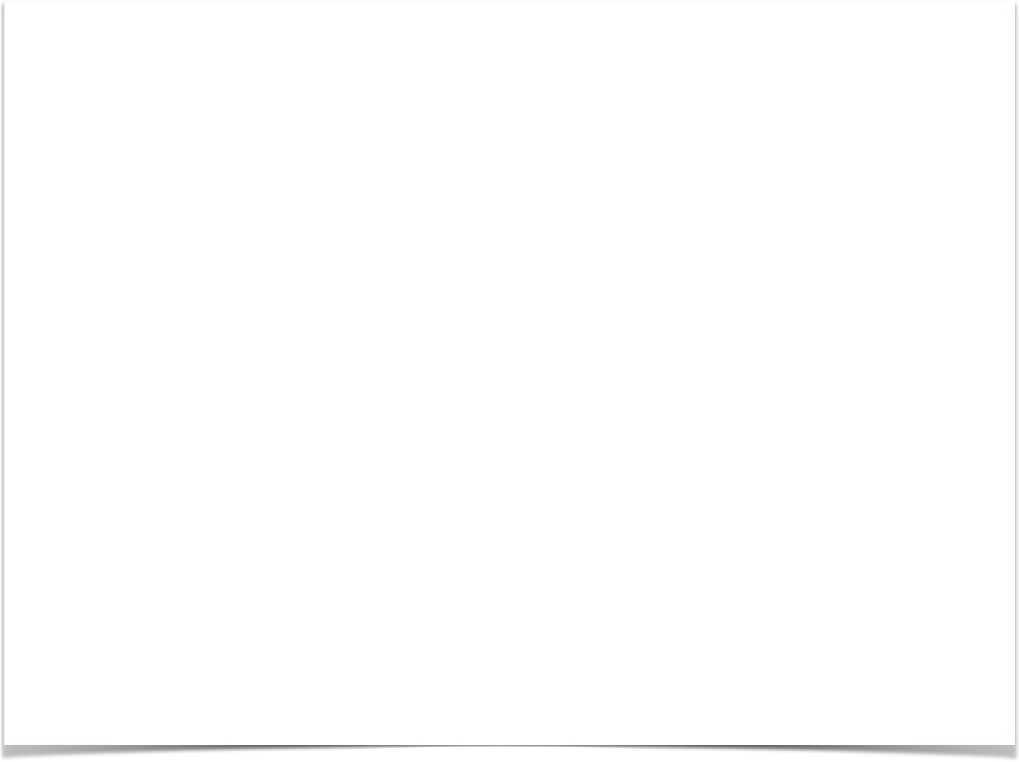
Step 1b: Create CourseCodeConstraintValidator
Advanced
import jakarta.validation.ConstraintValidator;
import jakarta.validation.ConstraintValidatorContext;
public class CourseCodeConstraintValidator
implements ConstraintValidator<CourseCode, String> {
private String coursePrefix; @Override
public void initialize(CourseCode theCourseCode) { coursePrefix = theCourseCode.value();
}
@Override
public boolean isValid(String theCode,
ConstraintValidatorContext theConstraintValidatorContext) {
boolean result;
if (theCode != null) {
result = theCode.startsWith(coursePrefix);
}
else {
result = true;
}
return result;
}
}
.

